Slide 1
LTFT
Pay

Slide 2
2016 Contract
Basic pay is calculated pro-rata
Nights and weekend allowance are also pro-rata over the course of the rota
LTFT pay premium = £1000

Slide 3
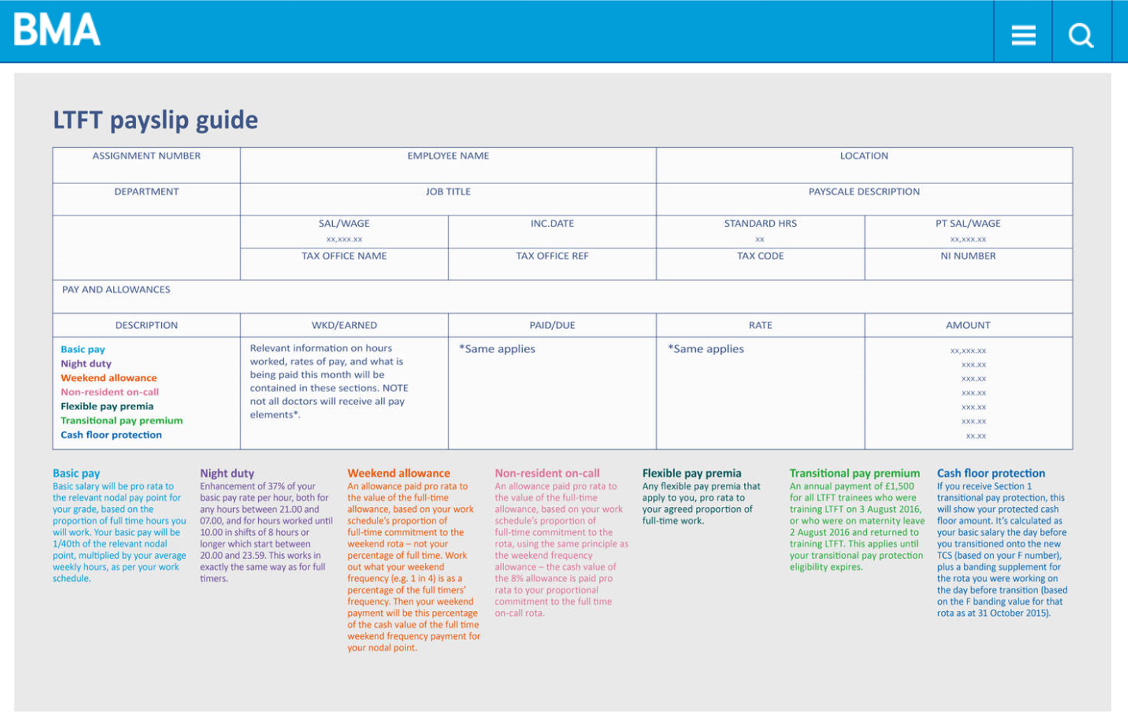

Slide 4
Professional Expenses
May be eligible for 50% reduction in GMC fees if annual earnings below a given threshold
Medical Indemnity Insurance quotes may be lower
The BMA offer reduced subscriptions to LTFT trainees with earnings below a given threshold
Some Royal Colleges offer reduced fees to LTFT trainees

Slide 5
Consultant jobs
Time spent as LTFT during training can affect which point on the payscale you start as a consultant

Slide 6
Consultant Jobs
For Example
Additional time spent in training due to LTFT = 2 years
Sarah finishes her 8 year paediatric run-through training and is successfully appointed to a consultant post.
During training she has:
•Completed ST1-4 full-time 4 years
•Taken 2 years as OOPR to complete a MD 2 years
•Taken 12 months mat leave 1 year
•Completed ST5, 6 and half of ST7 at 60% 4 years 2 months
•Taken 12 months mat leave 1 year
•Finished ST7 and ST8 at 80% 1 year 10 months
Total time = 14 years
Starting point on payscale = Year 3
(or sometimes Year 5)

Slide 7
Pensions
NHS pension - tiered system
% you pay is determined by your basic income
Bands applying to trainees:
£26,824 - £47,845.99 - 9.3%
£47,846 - £70630.99 - 12.5%
LTFT trainees pay pension contributions according to their salary. However the rate is determined by their full-time equivalent
Eg. A trainee who is earning £50,000 basic salary while working full time will earn £30,000 basic salary if they become LTFT at 60% but they will pay pension contributions at 12.5%

