Slide 1
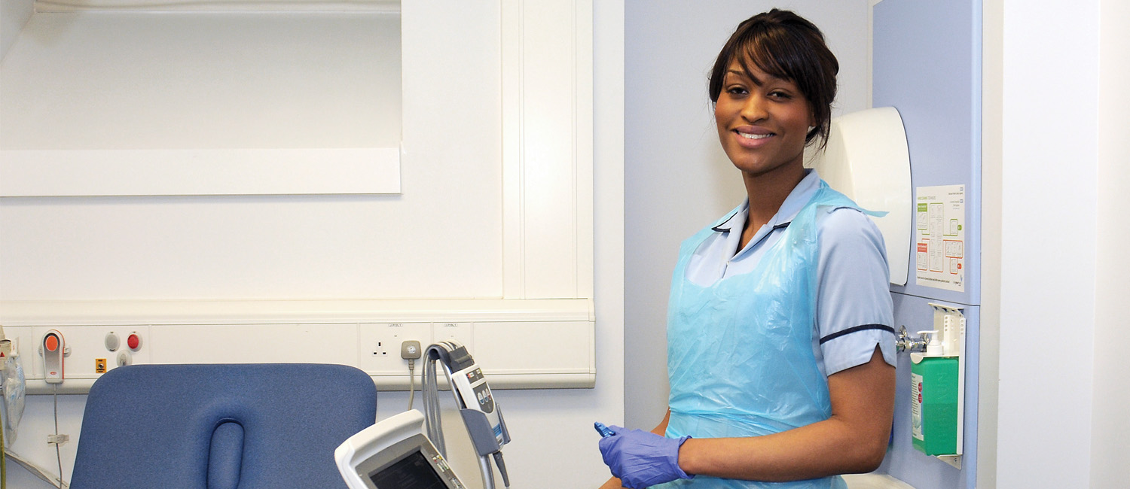

IQI Day 1
Health education England across Yorkshire & Humber

Slide 2
Welcome
@NHS_HealthEdEng HEE across Yorkshire & Humber 2016 ©
Notes:
Introduce facilitators for the day.
Housekeeping notices: phones to silent, fire alarms and exits, toilets

Slide 3
Aim: Understand the basics of QI l
By the end of the session:
Understand:
  Quality in healthcare
  What quality improvement is
  What a quality improvement project (QIP) is
  How to start making a change
@NHS_HealthEdEng HEE across Yorkshire & Humber 2016 ©
Notes:
This is to set the scene and help focus the trainees on what they should expect to get from today. This may be a good point to see if anyone has done a QIP before.

Slide 4
                Overview
09.00 Introduction & welcome
09.15 Patient Story
09.30 What is quality and what is QI?
10.00 The Model for Improvement
10.45 Coffee Break
11.00 Group activity: prototyping
11.40 Tools for defining the problem
12.00 Local Perspectives
12.15 Quality is personal Project
12.50 Closing and Feedback
@NHS_HealthEdEng HEE across Yorkshire & Humber 2016 ©
Notes:
Overview of timings, there is flexibility with them.

Slide 5
A patient’s story
@NHS_HealthEdEng HEE across Yorkshire & Humber 2016 ©
Notes:
A patient story is often used as a tool to help people relate to the project you are setting up, it can act as a hook to get interest. This has been used very effectively in Sweden with the story of Esther and elderly women who lived alone as was used as an example to change the way care was delivered to elderly people in the community to be patient centred. In my experience most QIP start from a patient story that has effected us and makes us want to change the status quo....to make things better. The description of story is to illustrate why we need to seek continuous improvement and how errors can go wrong as we are all fallable and its often the systems that save us, but sometimes all the hole line up and harm can happen.
Below is my example; I find this easier to deliver if its is a story I know personally but this one can be used, it is a little harrowing.
When I was working as a neonatal Registrar we had a very sad case that has changed the way people work. The lady who starts my story I’m going to call Nadia, she was pregnant and expecting her first child, the whole family were excited. This was to be the first baby of the couple and the first grandchild. When she was 38 weeks she had popped to see family that lived in London. Whilst she was there she had some discharge and being a first time mother wasn’t sure if this was her waters breaking so had gone for review. She was told all was ok, the CTG was normal, they wondered if her hind waters had broken and a swab was taken. She’d left her green hand held notes at her family house so nothing was written down in that record. The family returned to back home up North. A week later she started to feel some pains......so they came to the hospital I worked in. She was seen and triaged and deemed low risk first time mother. The labour was long and slow and she continued on the midwife led unit as per her birth plan. Just before her daughter was born she had a low grade fever 37.8oC. When her little girl was born she was pale, floppy...she wasn’t breathing, she didn’t have a heart rate so the crash call was sounded and this is when I met Nadia. Despite a long resuscitation we couldn’t save her little girl and she never took her first breath.

Slide 6


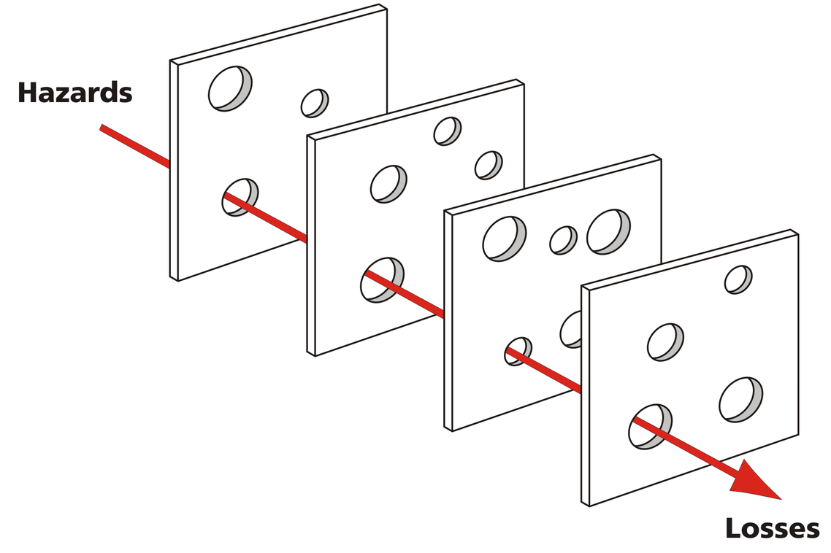
Part of the Yorkshire and Humber AHSN
@NHS_HealthEdEng HEE across Yorkshire & Humber 2016 ©
Notes:
So what had happended, what ahd gone wrong. How had the system let Nadia and her daughter down?
The Swiss Cheese Model likens human systems to multiple slices of swiss cheese stacked side by side and the risk of a threat becoming a reality is mitigated by these different layers of defense in our system. However are systems arent perfect and sometimes the holes all line up, like in our story and we get the bad outcome. (for reference: The model was originally propounded by Dabte Orlandella and James T Reason at University of Manchester aka cumulative acte effect.

Slide 7
What had gone wrong?
Poor Communication
  No plan given to patient re when to seek review
  No info handed over to local team
  Not brought in earlier/flagged up for review
When arrived not realised that she was PROM
  Changed from low ->high risk
  LW and active monitoring
  ?speed up delivery
Swab in London- had grown GBS
  ?Abx in labour
  Lower threshold hold for looking for infection
@NHS_HealthEdEng HEE across Yorkshire & Humber 2016 ©
Notes:
This will need changing if you chose a different story to tell.
If not;
Nadia had not been given a plan of if and when she should seek medical review. It would often be within 48hrs if not in labour and suspected waters broken and would have been flagged up for early review. The information was not handed over locally – this is a common everyday labour ward will see women out of area as 9months is along time to stay in one place and people move about. No coherent easy way to communicate between different trust in region let alone outside.
Nadia is not medical so didn’t reaslie she was a Prolonged Rupture of Membranes (PROM) as not aware this is what had happened in London and not in her hand held notes as they hadn’t been with her. This would have changed her care in labour. She would have been come high risk, had more monitoring and maybe delivered earlier.
The swab taken in London grew Group B Strep, this is a tricky bug as to a paediatrician it means baby death, it kills devastatingly quickly. But lots of women are colonised with it without consequence but it would have meant with the additional risk factor of PROM Nadia would have had antibiotics in labour and we would have been more concerned about that low grade fever.

Slide 8
How would you feel?
As the patient?
As the patient’s family?
As the Doctor?
@NHS_HealthEdEng HEE across Yorkshire & Humber 2016 ©
Notes:
Now I want you all to just take a minute and think how would you feel...as Nadia? As her family or as one of the doctor’s involved in her care.
Try to get some reflection from the group.

Slide 9
How do organisations
‘improve’ themselves?
Part of the Yorkshire and Humber AHSN
Some thoughts ...
@NHS_HealthEdEng HEE across Yorkshire & Humber 2016 ©
Notes:
And this is why we need to talk about how organisations improve themselves and how we change the complex systems in which we work.

Slide 10
Thought number 1
Part of the Yorkshire and Humber AHSN
Nobody goes to work
to do ‘a bad job’.
@NHS_HealthEdEng HEE across Yorkshire & Humber 2016 ©
Notes:
Nobody involved in Nadia’s care did anything deliberately wrong, everyone was working hard at their jobs but the systems within which we work allow the bad outcome.

Slide 11
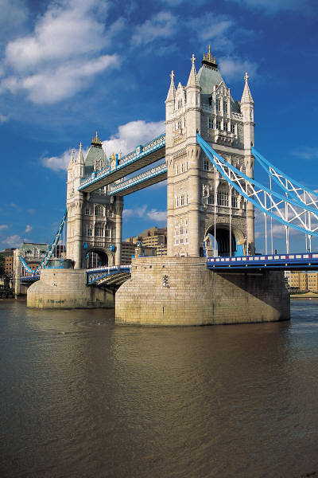
Thought number 2
Part of the Yorkshire and Humber AHSN
Form follows function
... but is this true in the NHS?
@NHS_HealthEdEng HEE across Yorkshire & Humber 2016 ©
Notes:
If I gave you a piece of paper and said design the NHS...can anyone honestly say they would design it the way it is today? Since its creation we have been growing incrementaly and bolting bits on and the form we now have isn’t necessarily the best for the function we need.

Slide 12
Thought number 3
Part of the Yorkshire and Humber AHSN
“Every system is perfectly designed to achieve exactly the results it gets.”
Donald Berwick
So ... if you want different results you have to change the system.
@NHS_HealthEdEng HEE across Yorkshire & Humber 2016 ©
Notes:
This sounds really simplistic but actually makes a lot of sense. If we keep doing the same things will just keep getting the same results!

Slide 13
Thought number 4
Part of the Yorkshire and Humber AHSN
Not all ‘change’ = ‘improvement’
@NHS_HealthEdEng HEE across Yorkshire & Humber 2016 ©
Notes:
The example I give here is that when I was a house office there was a top down instruction in the trust to reduce the number of hospital acquired infections such as c difficile but ensuring that the comodes were cleaned – so they had to be signed off as clean hourly by the nursing staff. This lasted 4 days before being abandoned due to the unforeseen consequences of taking staff away from patient care and the increased number of falls on our ward.

Slide 14
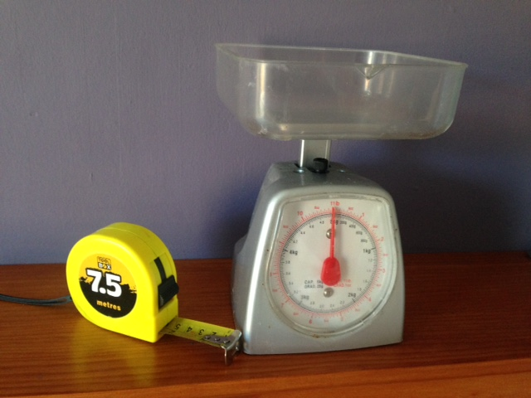
Thought number 5
Part of the Yorkshire and Humber AHSN
How do we know when things are changing?
We use objective measures:
For example
@NHS_HealthEdEng HEE across Yorkshire & Humber 2016 ©
Notes:
Therefore to know if a change is an improvement we need measurements. These measurements need to be objective for example unless you’re really good you’d use weighing scales if you want to win the great British bake off!

Slide 15
In Summary
Part of the Yorkshire and Humber AHSN
BAD systems not people
The NHS has evolved incrementally - so it’s no-one’s ‘fault’ if systems don’t work well
Need to change system if we want to make the system better
We don’t always recognise the difference between ‘change’ and ‘improvement’
  objective ways to measure impact of change
  Test our changes before we implement
@NHS_HealthEdEng HEE across Yorkshire & Humber 2016 ©
Notes:
3. Sometimes you need to change things radically within the system, to be a true healthcare radical need to rock the boar but stay in (Helen Bevan)

Slide 16
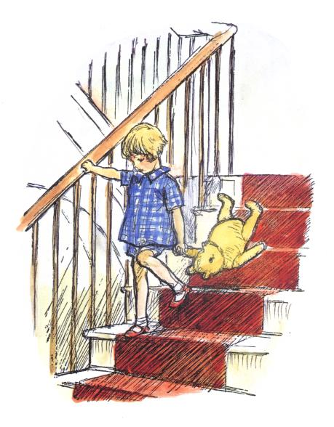
Part of the Yorkshire and Humber AHSN
“Here is Edward Bear, coming downstairs now, bump, bump, bump on the back of his head, behind Christopher Robin.
It is, as far as he knows, the only way of coming downstairs, but sometimes he feels that there really is another way, if only he could stop bumping for a moment and think of it”.
AA Milne – Winnie the Pooh
@NHS_HealthEdEng HEE across Yorkshire & Humber 2016 ©
Notes:
This is just for reflection/to highlight the point can easily be removed if prefered

Slide 17
What do we mean by quality in health care?
@NHS_HealthEdEng HEE across Yorkshire & Humber 2016 ©
Notes:
Encourage groups to think over 2-3 mins about what quality is in the health care setting, what to them makes a quality healthcare then go round the tables to see if can find the 6 aspects as per the institute of medicine (patient centred, safe, effective, equity, efficient, timely) and as “the extent to which health services provided improve desired health outcomes”.
Tip: if the group is struggling get them to think abut quality in general e.g what would be a good quality holiday location/weather/people etc then move them onto healthcare.

Slide 18
Quality
Effectiveness
Patient Centred
Safety
Equity
Timeliness
Efficiency
Part of the Yorkshire and Humber AHSN
No needless pain or suffering
For all
No helplessness in those served or serving
No unwanted waiting
No waste
No needless deaths
@NHS_HealthEdEng HEE across Yorkshire & Humber 2016 ©
Notes:
To reiterate the different aspects of quality in healthcare.

Slide 19
Systems & Processes
System:
A collection or processes organised around a purpose
Process:
A series of work activities that transform inputs to
Outputs for the benefit of someone
The systems we work in are inherently complex
*BUT when things go wrong we often focus on who to blame → remove the bad apple
@NHS_HealthEdEng HEE across Yorkshire & Humber 2016 ©
Notes:
In order to understand the healthcare system we work in we need to appreciate that we work within a very complex system and what a system and process is. The system is the collection of the processes if things break down at the process level or the processes work in a way that allow errors to occur, a bit like the holes in the swiss cheese. There is often a culture of looking for who to blame when something goes wrong rather than looking at the system, the processes and human factors involved in it to see how we can stop errors fro happening and reoccurring. In this instance we are years behind the safety and improvement culture in for example the aviation field. The system can often in healthcare be thought of to analyse as in the 5 P’s – Purpose (aim of the system), Patients, professionals (anyone involved in patients care), processes (all steps in patients care, sequential or overlapping), performance patterns (cost, safety, satisfaction, communication etc). If we understand the system in can help us develop a theme to improve it by.

Slide 20
What is quality improvement?
@NHS_HealthEdEng HEE across Yorkshire & Humber 2016 ©
Notes:
In groups give them 2-3 mins to think about what we mean then when we say quality improvement

Slide 21

Part of the Yorkshire and Humber AHSN
“QI is an organised system to continually improve processes, outcomes, and service, regardless of prior excellence, in order to be the best we can be."
– Brent C. James
@NHS_HealthEdEng HEE across Yorkshire & Humber 2016 ©
Notes:
Quote is from Chief Quality Officer and Executive Director, Institute for Health Care Delivery Research

Slide 22
What does it REALLY mean?
Part of the Yorkshire and Humber AHSN
An attempt to improve an aspect of the system we work in
Any attempt – the smaller the better
Any aspect – clinical or non-clinical
Anybody can do it (everybody should do it)
@NHS_HealthEdEng HEE across Yorkshire & Humber 2016 ©

Slide 23
Continuous improvement
Part of the Yorkshire and Humber AHSN
@NHS_HealthEdEng HEE across Yorkshire & Humber 2016 ©
Notes:
The aim should be to have continued improvement, rather than settling and stopping we keep improving the system and keep shifting the goal posts, by this way you shift the bell curve so more behaviour overall will be high quality. In this theory we should seek at positive deviants ie those performing far greater, achieving better quality care than others and aim to learn from them – share the knowledge and excellence. For example if one ward is consistent having less fall than others why?

Slide 24
Part of the Yorkshire and Humber AHSN
Usual approaches to change in a complex environment
Trial & Error?
Chaos
Too much action,
not enough thinking
Macho management
Just going ahead and doing it
Detailed prior study?
Paralysis
Too much thinking
not enough action
“We can’t do anything
until we know exactly
what to do…”
“Trial and Learning” Approach
@NHS_HealthEdEng HEE across Yorkshire & Humber 2016 ©
Notes:
Introducing change can be difficult and time-consuming. We want a means of introducing new ideas that provides a balance between just going ahead and doing it and spending too much time thinking, which often means things don’t get off the ground. Traditionally as medics we tend to lean towards the safe approach of sitting in a darkened room and thinking or all possible scenarios but not starting anything as we’re looking for the perfect solution.
Trial & learning approach is a mix of both and means that you can apply ideas in your own setting. There is also little risk involved.

Slide 25
Audit Versus QIP
Audit sits under the umbrella of Quality Improvement
→BUT is often not used effectively to achieve improvement
 | Audit | QIP
Data | Endpoint | Resource to show change needed/improvement made
Method | Scientific rigour | Collaborative, learning
Standards | National clinical standards or guidelines | Often no actual standards agreed in patients safety/experience or service
Time to change | Months | weeks
Review | 6 months + or ?never | Daily or weekly
Notes:
I would start by asking who here has done an audit hands up (expect 100%) as a mandatory art of Foundation year. Now keep hand up if who has completed the audit cycle? (expect very few). Some studies looking at audits in hospitals have shown that 27% on audits started are completed, only 22% re-audited and only 5% led to change. This is why we have seen a shift towards QIPs especially for junior doctors as they should remove many of the barriers – such as short time in department due to rotation, often handed a “tick Box” audit, not able to complete cycle to see if change effected or works, not very satisfying process.
As a junior doctor a QIP should be something that you can chose to tackle (that you see as a local problem), to effect change in a timely manner ie within a 4-6 month rotational job. It should help you feel part of the bigger team as you need to work collaboratively with the MDT and this style of work is more likely to tackle some of the human factors towards making change. It should also be very locally applicable.
References for figures on audits (John CM, Mathew DE, Gnanalingham MG. An audit of paediatric audits. Arch Dis Child 2004;89:1128-9.
Guryel E , Acton K, Patel S. Auditing orthopaedic audit. Ann R Coll Surg Engl 2008;90:675-8.
Stanton E. An audit of audits. London Deanery, 2009 (unpublished data).

Slide 26
Part of the Yorkshire and Humber AHSN
The Model for Improvement
@NHS_HealthEdEng HEE across Yorkshire & Humber 2016 ©
Notes:
Next to discuss the model for improvement, this isn’t the only one but is an easy one to use and one that people are most familiar with.

Slide 27
Part of the Yorkshire and Humber AHSN
Model for Improvement
What are we trying to
accomplish?
How will we know that a
change is an improvement?
What change can we make that
will result in improvement?
Langley G, Nolan K, Nolan T, Norman C, Provost L, (1996), The improvement guide: a practical approach to enhancing organisational performance,
Jossey Bass Publishers, San Francisco
Act
Plan
Study
Do
@NHS_HealthEdEng HEE across Yorkshire & Humber 2016 ©
Notes:
It was developed in the 1980s, not specific to collaboratives.
To be successful, any improvement effort must start by addressing the three basic questions shown here:
1. The first question is about setting an aim that is measurable, specific, and yet an aim that requires taking the status quo off the table in order to achieve it.
2. The second question requires that the team decide on how it will measure its progress in reaching the aim. For example: you don’t know whether your golf game is improving unless you keep track of the number of strokes per round.
This gives teams a place to start - with changes that have been shown to be effective. This question is based on the assumption that all improvement requires change, but not all changes lead to improvement.

Slide 28
Part of the Yorkshire and Humber AHSN
Model for Improvement
What are we trying to
accomplish?
Understanding the problem. Knowing what you’re trying to do - clear and desirable aims and objectives
How will we know that a
change is an improvement?
What change can we make that
will result in improvement?
Langley G, Nolan K, Nolan T, Norman C, Provost L, (1996), The improvement guide: a practical approach to enhancing organisational performance,
Jossey Bass Publishers, San Francisco
Act
Plan
Study
Do
@NHS_HealthEdEng HEE across Yorkshire & Humber 2016 ©
Notes:
So if we start with the first question which is essentially setting an aim, and we want this to be a SMART one. Does anyone know what is meant by a SMART aim? It is similar to the framework used to write our PDPs on e-portfolio.
Later today we discuss more about how you can analysis the problem.

Slide 29
Set the aim: it should be
Part of the Yorkshire and Humber AHSN
Time specific and measurable –i.e. ‘how much’ & ‘by when’
Define specific group of patients affected
Agreed by the team
Resourced
Time framed
Clear enough to guide the work BUT
grand enough to excite participants
@NHS_HealthEdEng HEE across Yorkshire & Humber 2016 ©

Slide 30
Examples of how (not to) write an aim
Part of the Yorkshire and Humber AHSN
✗We will decrease falls
We will decrease falls by 20%
We will decrease falls on Ward 23 by 20% from baseline by the end of December 2015
Note: its is importance to have a clear operational definition.
@NHS_HealthEdEng HEE across Yorkshire & Humber 2016 ©
Notes:
The task is for the group to look at improving falls in the trust ask them to give you an example of an aim.
You’re looking for them to give you something that is SMART if not illustrate why important for e.g if they say all falls I often say not really a problem on the paediatric ward!
The operational definition refers to 20% reduction from baseline, important everyone is using same objective measure and aiming for same goal. Importantly this doesn’t tell you the path you need to take to get to this goal and often different changes needed in different places. It allows those involved to use their own analysis of problem for example at LTHT there was a falls reduction QIP but each ward tackled differently one had a toilet round pre drugs round with added beenfit of an undisturbed drugs round another sawed a desk in half as unsteady patients trying to negotiate round it was causing falls – rarely a one glove fits all solution!

Slide 31
Part of the Yorkshire and Humber AHSN
Model for Improvement
What are we trying to
accomplish?
How will we know that a
Measuring processes and outcomes
change is an improvement?
What change can we make that
will result in improvement?
Langley G, Nolan K, Nolan T, Norman C, Provost L, (1996), The improvement guide: a practical approach to enhancing organisational performance,
Jossey Bass Publishers, San Francisco
Act
Plan
Study
Do
@NHS_HealthEdEng HEE across Yorkshire & Humber 2016 ©
Notes:
The next step is to decide on what measurements you will need to decide if your change has been an improvement.
This is critical for knowing whether or not changes being introduced are leading to improvement. It is important to remember that the measurement is for learning, not for judgement. You will always need a baseline starting point of measurements.

Slide 32
Part of the Yorkshire and Humber AHSN
Types of Measurement
Measurement can be split into the reason why you are measuring:
Research
Performance Monitoring (Accountability)
Quality Improvement
@NHS_HealthEdEng HEE across Yorkshire & Humber 2016 ©
Notes:
There are 3 main types of measurements in the world of healthcare and it is important to understand how those used in quality improvement are different from those you will be more familiar with. Research measurements are the ones used in PhD and when looking at evidence based medicine and appraising research. The performance monitoring are the ones that can make people nervous as is used to compare centre to centre or surgeon to surgeon. For example in recent years performance monitoring has been usesd restructured children’s heart surgery.

Slide 33


Three types of measurement
Aspect | Improvement | Accountability | Research
Aim | Improvement of care | Comparison, choice, reassurance | New knowledge
Methods | Tests are observable | No test evaluation of current performance | Test blinded or controlled tests
Bias | Accept consistent bias | Measure and adjust to reduce bias | Design to eliminate bias
Sample Size | “Just enough” data, small sequential samples | Obtain 100% of available, relevant data | “Just in case” data
Flexibility of Hypothesis | Flexible, changes as learning takes place | No hypothesis | Fixed hypothesis
Testing Strategy | Sequential tests | No tests | One large test
Determining if a Change is an Improvement | Run charts or Shewhart control charts | No change focus | Hypothesis, statistical (p values)
Confidentiality of the Data | Data used only by those involved with improvement | Data available for public consumption and review | Research subjects’ identities protected
HEE across Yorkshire & Humber 2016 ©
Notes:
This highlights how the measures used in quality improvement are a different way of thinking.
AIM: The aim is different in improvement we are always thinking of the how can we improve and change. In research we are asking the “what” in a search for new knowledge.
BIAS: When you set up a research trial you try and remove all possible bias and confounding factors whereas in QI we accept that the bias, but see it as consistent within the system.
SAMPLE SIZE: If collecting data for a PhD you will often collect surplus data just in case but for QI we are sampling just enough – the saying that you don’t need to try the whole pot of soup to know it tastes good, only need a spoonful! The importance here is in frequent small measurements that allow us to see the normal variation within the system, taking account of the inherent biases and looking for a change from the baseline.
HYPOTHESIS: in QI the hypothesis is not fixed, in fact it is important that it can change and it is part of the learning process to find out what works, testing one small change (or hypothesis) at a time and changing it as we learn from what we have done. In conducting research it is essential to have a fixed hypotheis to prove or disprove.
TESTING: In research one big test whereas in QI its a step by step process of testing small sequential changes.
IS IT AN IMPROVMENT?: the analysis is much simpler in QI at the basic level is a run chart in excell where you plot data points against time to see if change is an improvement. Much simpler that the complex statistics of chi squared etc
DATA: It is important to stress that the data in QI is for the team involved in the change to see if what they are doing is working not for national comparison. Although its is useful to display it in an accessible way for the team.

Slide 34
Three types of ‘measurement for improvement’
Part of the Yorkshire and Humber AHSN
Outcome measures
Process measures
Balancing measures
@NHS_HealthEdEng HEE across Yorkshire & Humber 2016 ©

Slide 35
(i) Outcome measure
Part of the Yorkshire and Humber AHSN
= How is the system performing?
Think:
What to measure (and how)
How frequently
Establishing the baseline
For example:
Number of patients falling
Daily Vs weekly
@NHS_HealthEdEng HEE across Yorkshire & Humber 2016 ©
Notes:
This simply looks at how well is the system performing and should be linked to your aim. It is important to think what you therefore need to measure and how frequently. It is good to try and incorporate the measurement into systems that already are in place and think about the logistics of collecting. It is hard work maintaining the enthusiasm to keep collect, you need to make it as easy as possible.

Slide 36
(ii) Process measure(s)
Part of the Yorkshire and Humber AHSN
= Are the processes (parts/steps) in the system performing as planned?
Think
What to measure (and how)
How frequently
Establishing the baseline
E.g. What % of patients received a falls risk assessment
How many times/day are we intentionally rounding ?
@NHS_HealthEdEng HEE across Yorkshire & Humber 2016 ©
Notes:
This is where you look at the processes we have within in a system to see if they are working or if this needs improvement. For example to stop people falling we do falls assessments if theses are not being done and vulnerable patients not picked up this may be why our baseline measure number of falls is not improving. If this was 100% and number of falls still high/not improving need to look at process and see why not working.
Intentionally rounding is having a set “round” of patients to see if need toilet/drink etc rather than them waiting to call to see if can decrease number of falls.

Slide 37
(iii) Balancing measure(s)
Part of the Yorkshire and Humber AHSN
= Unintended consequences.
Aka yes, but.......
What would you worry about?
@NHS_HealthEdEng HEE across Yorkshire & Humber 2016 ©
Notes:
It is important to address balancing measures for 2 reasons. These could potentially be serious and you may have unintended consequences of your actions, if you take resources from one place what will happen as a result...if you remember back to my comode cleaning anecdote and the falling patients. Its also a way of overcoming resistance by asking people what are they worried about with the changes and if you can incorportae this in to your measurements you can then show it isnt a problem. For example when we looked at changing the phlebotomy service at Leeds and trying to get requests put out for phlebotomy not the night SHOs people said “yes but they’ll just get handing back and we’ll end up doing them in daytime”. So therefore as our balancing measure we measured failure rate aka forms handed back.

Slide 38
Part of the Yorkshire and Humber AHSN
Measurement: key points
Measures are used to guide improvement
Focus on the vital few
Try to integrate measurement into your routine
Define numerator and denominator
5/10 (50%) Vs 5/5 (100%)
Plot your data over time
Make run charts visible – they provide important feedback
@NHS_HealthEdEng HEE across Yorkshire & Humber 2016 ©

Slide 39
Part of the Yorkshire and Humber AHSN
Why Run charts ?
Easier to assimilate info from charts than tables
Can display data to make performance visible
Determine if change resulted in improvement
Can see if ‘holding the gains’ made by improvement (sustaining)
@NHS_HealthEdEng HEE across Yorkshire & Humber 2016 ©

Slide 40
A simple run chart
A simple run chart
Re-launch
Expansion, L10 first
Number blood test by phlebs
Baseline data
Time, days
@NHS_HealthEdEng HEE across Yorkshire & Humber 2016 ©
Notes:
This is an example of a run chart, it is from the phlebotomy project where we looked at trying to improve the utilisation of the phlebotomy service. We measured daily the number of blood tests done by the phlebotomist.
Note the first 2 week period up to day 14 where we collected our baseline data, to see the normal variation in the system and establish the median (red line). We then made the first change – the re-launch and continued to collect data, before studying it then making second change the expansion. As you can see things improved each time after the change with a new median being set.

Slide 41
Part of the Yorkshire and Humber AHSN
Model for Improvement
What are we trying to
accomplish?
How will we know that a
change is an improvement?
What change can we make that
will result in improvement?
What have others done?
Act
Plan
What hunches do we have? What can we learn as we go along?
Study
Do
@NHS_HealthEdEng HEE across Yorkshire & Humber 2016 ©
Notes:
The next step is the fun part...what changes can you make? You will often have hunches about what you think is the problem and what one change could “fix it”. However when you look at the problem in detail, as we will discuss later when going over tools to analysis a problem you will see there are often lots of different things that feed into it.
So we know that to improve needs change but not all change leads to improvement so we must test it.
The PDSA , plan do study act is often used to asses these hunches and is based on the theory of doing lots of small changes, sequential to lead to be sustained improvement.

Slide 42
Part of the Yorkshire and Humber AHSN
Test your changes: the PDSA Cycle
Act
Plan
What changes are to be made?
Next cycle?
Objective
Questions and
predictions (why)
Plan to carry out the cycle (who, what, where, when)
Study
Do
Complete the analysis of the data
  Compare data predictions
    Summarize what
    was learned
Carry out the plan
Document problems and
unexpected
observations
Begin analysis of the
data
@NHS_HealthEdEng HEE across Yorkshire & Humber 2016 ©

Slide 43
Part of the Yorkshire and Humber AHSN
Next
Hunch
ACT
PLAN
STUDY
DO
Reflection
Test
@NHS_HealthEdEng HEE across Yorkshire & Humber 2016 ©
Notes:
43
Or more simply inductive learning – the growth of knowledge through making changes and then reflecting on the consequences of those changes

Slide 44
Why use PDSA?
Part of the Yorkshire and Humber AHSN
Test change in real-time in the work place
Small rapid scale testing:
  Minimises resistance
  Will the change work in environment in question
  Safe and low risk as refining change & checking works before implementing on a broader scale
  1, 3, 5, all!
@NHS_HealthEdEng HEE across Yorkshire & Humber 2016 ©

Slide 45
Developing Practice Improvement
Part of the Yorkshire and Humber AHSN
PDSA
PDSA
PDSA
PDSA
PDSA
Increasing Team Intelligence & Awareness
PDSA
Problem
Identified
Change in Team Culture
@NHS_HealthEdEng HEE across Yorkshire & Humber 2016 ©
Notes:
45
To summarise you work out the problem the tackle it making small incremental changes and during this process this will increase team awareness and intelligence about the problem and the changes. This should ultimately lead to a change in the team culture.

Slide 46
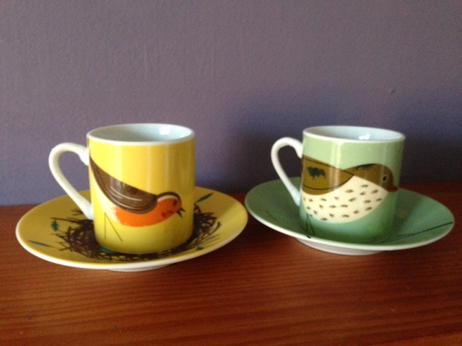
Coffee Break
Coffee Break
@NHS_HealthEdEng HEE across Yorkshire & Humber 2016 ©
Notes:
20 minute coffee break, don’t forget to tell them time to be back and gives time to set up marshmallow challenge.

Slide 47

@NHS_HealthEdEng HEE across Yorkshire & Humber 2016 ©
Notes:
The Rules:
In teams you have 18 minutes to construct the Tallest free standing structure (ie you can not suspend it from something higher like the ceiling!). The WHOLE marshmallow must be on top ie not cutting in half. You can use as much or as little of the kit as you wish, you can break the string/spaghetti or tape if you wish. To be clear your operational definition is to build the tallest free standing tower using equipment on the desk only and must have the whole marshmallow on the top.
Top tips; they will find anyway possible to cheat! Its important to allocate the kit to each table ie exact number of spaghetti and measure out lengths of string and tape. I offer a prize of a box of chocolates to winning team. See separate instruction info for more details.

Slide 48
http://marshmallowchallenge.com/Welcome.html
@NHS_HealthEdEng HEE across Yorkshire & Humber 2016 ©
Notes:
This is an interesting summary of the use of the marshmallow challenge and learning points – check where you are giving as not all trust will let this play.

Slide 49
What did we learn?
Small steps
Test regularly
Learn from trials
Not all change is improvement
@NHS_HealthEdEng HEE across Yorkshire & Humber 2016 ©
Notes:
The Marshmallow is a Metaphor for the Hidden Assumptions of a Project: The assumption in the Marshmallow Challenge is that marshmallows are light and fluffy and easily supported by the spaghetti sticks. When you actually try to build the structure, the marshmallows don’t seem so light. The lesson in the marshmallow challenge is that we need to identify the assumptions in our project - the real patients needs, the cost of the product, the duration of the service - and test them early and often. That’s the mechanism that leads to effective innovation. You hopefully learnt the importance of small steps, tested regularly and how you can learn form this. And finally again, not all change is improvement.

Slide 50
Tools for defining the problem
Part of the Yorkshire and Humber AHSN
Driver Diagrams
Spaghetti Diagrams
Fish bone diagram
Process mapping
5 whys
Brainstorming
Mind maps
@NHS_HealthEdEng HEE across Yorkshire & Humber 2016 ©
Notes:
There are many different tools that can be used to look at a problem the one you pick can depend on preference and also the problem that you are looking.
Ask the group if anyone has ever used any of these and if yes what for? Was it helpful?

Slide 51
Driver Diagram
Primary drivers
Secondary drivers
Reduce fuel price per gallon
Research cheapest fuel
Aim/goal
Car share
Decrease fuel costs
Reduce miles drive
Bike/walk to work
↓ rapid
acceleration
Use gears correctly
Improve driving
pattern
Increase efficiency (mpg)
↓ rapid breaking
Buy more efficient car
@NHS_HealthEdEng HEE across Yorkshire & Humber 2016 ©
Notes:
This is a simple tool but good for getting you to break down the problem. Talk it through ie agree the goal or aim of your project this is a non-medical one to decrease the cost of monthly spend on fuel but could be to look at prescribing warfarin out of hours, falls on a ward etc. First think of the primary drivers ie what are the big things that determine this normally 2-4 things then look at if their is a secondary drier to this for example to increase efficiency this is determined by both the car and the operator of it ie driving skills. The bits in purple are the different ways you can impact on the secondary/primary driver and have an effect on the main goal. Theses are the bits you look at to develop a PDSA around and make one change at a time and test it. You will have a “hunch” about what is the real issue but you may be wrong and this makes you think about the whole problem and potentially any hidden assumptions you have.

Slide 52
Spaghetti Diagram
@NHS_HealthEdEng HEE across Yorkshire & Humber 2016 ©
Notes:
Spaghetti diagrams are generally used for looking at flow in a set space and helping to either decide where something should “live” like an observation trolley or as in this example cannulating a patient in a treatment room. On a piece of paper you draw the key features of the area being reviewed in this example the treatment room and the adjacent store room/drugs room. Then a person observed people doing the procedure and maps out their route – the squiggly lines. This helps to assess how and where you could make the change to improve efficeency then you would like at “steps saved” as outcome measure as would cont number steps on rotes done.

Slide 53
Fishbone (ishikawa) diagram
People
2 people
Environment
Hospital geography
Day team practice
Play support, AHP
Skills?
Bloods done by night team
Ametop/ cold spray
Taxi to St James
Sampling site
<2yrs
Blood bottles
Requesting process, knowledge, planning
Equipment
Processes & policy
@NHS_HealthEdEng HEE across Yorkshire & Humber 2016 ©
Notes:
The fishbone diagram is another way of mapping out a problem and thinking about it under main areas. This example is from a project to increase the use of paediatric phlebotomy services and decrease the number of blood tests being handed over to the night team to do for the ward round. We looked at all the reasons we though blood forms weren’t being done in a meeting amongst junior doctors, phlebotomy and consultants. The key points was a rule that they ward phlebotomists weren’t allowed to do blood tests on under 2 years – but also did the blood round on the neontal unit. Certain blood tests had to go on the 11am taxi to St James from L10 and no-body and junior level really understood waht phlebotomists could and couldn’t do! This formed the basis of starting the first PDSA in the project.

Slide 54
Process mapping
Sent in batches to lab
Hourly run
Patient referred to clinic
Patient checks into clinic
Blood sample taken
INR
tested
Result to patient
New appt made
Pt sent to wait
Result waits in queue
Pt sent to wait
Clinic
sends letter
Arrives at hospital
15-30mins
45-90mins
20-30mins
30% appts rearranged
Can’t park
Can’t find clinic
@NHS_HealthEdEng HEE across Yorkshire & Humber 2016 ©
10-15mins
Notes:
This is really good for looking at patient flow or looking at how a process works in the hospital. This example is for an outpatient warfarin clinic but could also be used for something like referral to other specialities looking at time from decision to be referred to review etc. You start with a broad overview of the process then (on click of mouse over bits appear) when you look at each step in more detail – need to really think about the nitty gritty you can see how many layers of delay are involved and how inefficient the whole thing is. This would need work as a starting point for trying to change the system. This should ideally be done as a MDT process and if possible follow a patient through the journey and observe what happens. This is the one that quite classically is done with a lot of post it notes!

Slide 55

5 Whys
Write down what problem is and ask why?
  If not solution ask why again and repeat
Brainstorming
Non judgemental & non threatening
environment
Gather list of spontaneous ideas
@NHS_HealthEdEng HEE across Yorkshire & Humber 2016 ©
Notes:
The 5 whys has been established in the NHS for quite a while and is the methodology behind root cause analysis – which some of you may have been involved in. I think of it as the annoying small child method where you talk about the problem with some one and they simply keep asking why!
For example a GP was trying to improve their QOF payment for flu jabs – they were sure they were identifying people and giving them but not registering on the system
BUT WHY? Well it needs to be coded on the system to register as given and its not registering
BUT WHY? Well I don’t know how to do the coding
BUT WHY? – lightbulb momement, need to get someone in to show how coding is done!
Brainstorming – is often referred to as lets brain storm that but rarely truly done. Its actually quite a hard skill as need to establish and nurture right environment. People need to feel safe to say anything then the problem is posed and people say the first thing on top of their head and a scraibe writes all day. The harder part is the then subsequent analysis of this list.

Slide 56
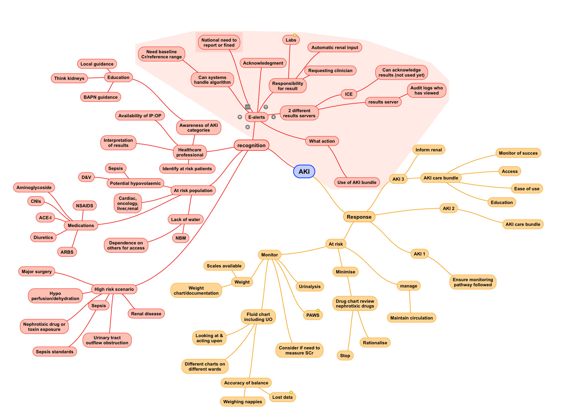
Mind Map
@NHS_HealthEdEng HEE across Yorkshire & Humber 2016 ©
Notes:
Or if you’re a very visual person then a mind map can be a helpful start where you look at the problem and think about all the possible factors feeding inot it. This one is looking at AKI in children in a tertiary hospital in thinking about producing care bundles.

Slide 57
Local Perspectives
+ Looking at a problem:
what frustrates & annoys you?
@NHS_HealthEdEng HEE across Yorkshire & Humber 2016 ©
Notes:
This is where you talk about what support is on offer locally for QIPs e.g. Quality improvement/transformation depratment, any IT resources, tools or contact details. If any local support or quality improvement forums exists.
The trainees need to know:
If they are expected to register their projects and if so how
If they need a named supervisor and if there are any restrictions on who it can be
If there is a database of projects available to see what others have done
If there is a pool of ideas if they are stuck but keen to be involved or could they do a lessons learned based on a incident/datix
This is now the point where there should be at least 45mins for them in small groups 5-6 ideally each with a facilitator to discuss the idea they have brought with them or encourage them to think of something that frustrates and annoys them or even a non-work related thing like losing weight, decreasing journey time to work. They then need to work through the problem using one of the tools to try and set an aim, discuss potential measures and how they could start a project.
This section is essential for ensuring they feel they have permission and support to start a QIP in the trust.

Slide 58
Homework
To bring to next session
Your quality is personal project:
Set an aim
Decide on your outcome measures
Collect your baseline measures
If not yet done:
On-line ‘bronze’ training:
http://qitraining.improvementacademy.org/
@NHS_HealthEdEng HEE across Yorkshire & Humber 2016 ©
Notes:
Then a wrap up and the end to remind them that there is homework to do before the next half day, ie work on the projects we have just been discussing and next time we will help them take the next steps...

Slide 59
Aim: Understand the basics of QI
Close and feedback:
By the end of the session:
Understand:
  Quality in healthcare
  What quality improvement is
  What a quality improvement project (QIP) is
  How to start making a change
@NHS_HealthEdEng HEE across Yorkshire & Humber 2016 ©
Notes:
Then bring them back to our original aim and goals for the session and close.

