Slide 1

End of Life Issues: Organisation of Palliative Care in the UK
Notes:
In this module we are describing end of life issues and in particular palliative care.
We will think about our role in patient care specifically when we have decided that we cannot cure the patient. As doctors it is frequently a difficult decision to accept that we can no longer think about the person in front of us as someone we can cure or even prolong their life. This may be because of the way we are taught at medical school and is inevitably made difficult because most patients put enormous faith and hope in the expectation that hospitals and specialist units will have the resources to diagnose our problems and then offer cure or at the very least a treatment which arrests the disease process and offers hope to us and our families.

Slide 2
History
1905 St Joseph’s Hospice, London
1967 St. Christopher’s Hospice, London, Dame Cicely Saunders
1987 Palliative Medicine as a specialty
+ 200 hospices in the UK
Each hospital should have the input of a palliative care specialist
Notes:
This module is to make you think about what a clinical incident is, what should happen if one occurs, and what happens afterwards to try and learn from the events.
A complaint may arise following a clinical incident, or following an episode of care where nothing adverse has actually happened. Many of the causes of complaints lie in the way that individual actions of doctors (junior AND senior) and other staff are interpreted by patients and their relatives.

Slide 3
Main areas of
Palliative Care
Hospices (free standing, day care, clinics)
Hospitals (consultations by nurses and doctors, clinics)
Community (consultations by Macmillan Nurses)
Notes:
A large amount of palliative care will go on in hospitals. This is probably a good time to think about what we mean by palliative care.
Palliative Care Defined
Palliative care is part of supportive care. It embraces many elements of supportive care. It has been defined by NICE as follows:
Palliative care is the active holistic care of patients with advanced progressive illness. Management of pain and other symptoms and provision of psychological, social and spiritual support is paramount. The goal of palliative care is achievement of the best quality of life for patients and their families. Many aspects of palliative care are also applicable earlier in the course of the illness in conjunction with other treatments.

Slide 4
Palliative Care is the
integration of:
Physical
Psychological
Social
Spiritual
Notes:
Palliative Care is provided by:
Palliative care is provided by two distinct categories of health and social care professionals:
Those providing the day-to-day care to patients and carers in their homes and in hospitals (you and your team)
Those who specialise in palliative care (consultants in palliative medicine and clinical nurse specialists in palliative care, for example)
Those providing day-to-day care should be able to:
Assess the care needs of each patient and their families across the domains of physical, psychological, social spiritual and information needs
Meet those needs within the limits of their knowledge, skills, competence in palliative care
Know when to seek advice from or refer to specialist palliative care services

Slide 5
Consolation
Palliative care
Complains
Observation
Cure
Chronic disease
Terminal disease
Bereavement
Working up, diagnosis
Elimination of disease
Suppressing disease
Symptom control, patient’s death
The place of palliative care in the history of (malignant)
disease
Notes:
This slide is reinforcing the notion that palliative care and palliation is a continuous process from the outset of symptoms until after death. Other types of care can still go on.
For instance whilst a patient with presumed and subsequently confirmed lung cancer is investigated to identify the type of disease he has and then to determine the best mode of treatment which in some cases can be curative surgery, then palliative care can and should be going on at the same time.
Remember that definition of palliative care:
Palliative care aims to:
Affirm life and regard dying as a normal process
Provide relief from pain and other distressing symptoms
Integrate the psychological and spiritual aspects of patient care
Offer a support system to help patients live as actively as possible until death
Offer a support system to help the family cope during the patient’s illness and in their own bereavement

Slide 6
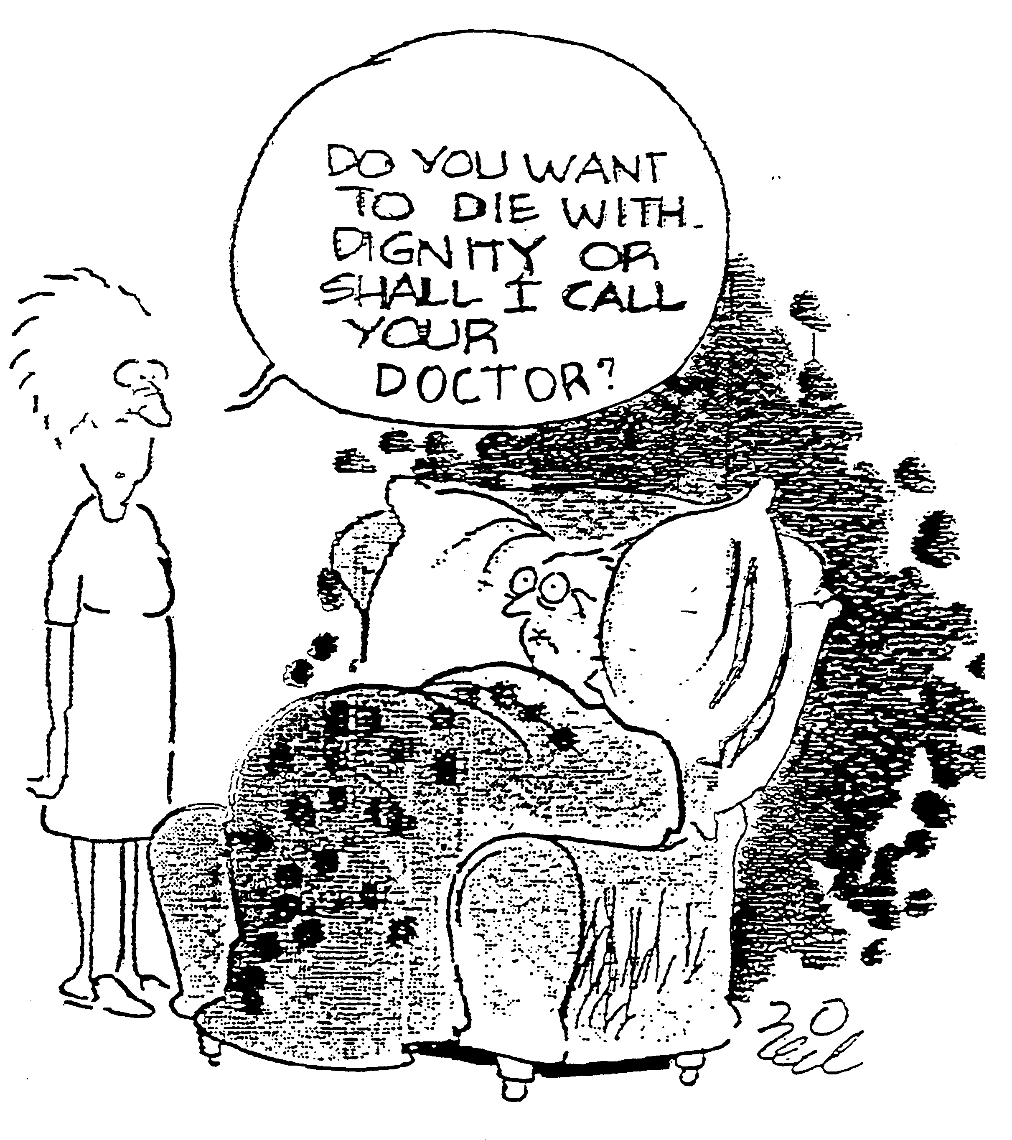
Notes:
Why is this slide funny?
Perhaps you do not think it is!
Why is it included in this presentation and what specific issues does it raise about doctors and end of life care?

Slide 7
Types of treatment
Curative
Revalidative (rehabilitation)
Palliative
Symptomatic
Notes:
As already stated all of these treatments might apply to the same patient.
An example:
Young man with fractured femur:
He will need symptomatic treatment (pain relief, maybe fluid/blood replacement)
Curative treatment (internal/external fixation)
Revalidation/rehabilitation once the bone is healed.
Clearly in this situation there is no advanced progressive illness so no palliation is required, but if the young man had fallen because he had developed a progressive neurological disorder – for instance Familial cerebellar ataxia, then there would be an early need for palliative care.

Slide 8
Components needed
for the feeling of dignity
Distress caused by symptoms
Lucidity
Quality of relationships
Spiritual “space” for the adaptation process
Acceptance
Safety
Peace and quiet
Caring surroundings/able to receive care
Good communication between the family and carers
Notes:
Unfortunately “a dignified death” has occasionally become mixed up with euthanasia. This module is not discussing that issue and indeed is not in any way arguing for euthanasia.
What most of us would want when we know that our own death is inevitable is to have all of these areas optimised where ever possible. (remember the cartoon on an earlier slide which was clearly intimating that involving a doctor in end of life care was likely to remove the dignity of death)
How many of these can you address in a patient in your ward or in out patients?

Slide 9
Patterns and
predictors of place of cancer death
Married men with cancer usually die at home
Women with cancer tend to die in care homes & hospices
Those dying of lymphatic & haematopoietic malignancies tend to die in hospital
Young people (< 30) tend to die in hospital or at home
Notes:
Why do you suppose in our culture that men will usually die at home but women do not?
Some of the issues I can think of will be:
Longer life expectancy of women – therefore women often living alone.
Women more able to adapt to the carer role than men.
Financial and or social demands requiring men to continue working when partners are ill.

Slide 10
phase 1
Notes:
We will discuss the phases of terminal illness

Slide 11
Phase 1
Lack of balance between facts and emotions
Disappointment, disbelief, lack of confidence
Lack of acceptance
The goals are unclear
“trial and error” in symptom control
Important: preserve the cognitive functions
Many patients contemplate euthanasia
Notes:
This gives you some insight into how your patient might be feeling at the onset of a terminal illness.

Slide 12
phase 2
Notes:
This is a time when the palliative care team will need to be at their most supportive.
It is also a time when patients are often admitted to hospital because of a crisis

Slide 13
Phase 2
Balance is recovered
Confidence is back
(Physical) symptoms are not at the foreground
The patient gets space for his adaptation process
Intact cognitive functions of paramount importance
Euthanasia requests practically fade away
Notes:
The Liverpool care pathway is a tool used in palliative care when the team managing a patient believe that the patient is likely to die of their illness within the next 48 hours and is to ensure that the patient is managed in the most optimum way.
It is not a once and for all decision and is certainly not a pathway to shorten life the patient must be reviewed continuously.
The aim of the pathway is
To improve care of the dying in the last days or hours of life
It is a multidisciplinary process, which aims to continually assess the dying patient and to identify variances (non achievement of treatment goals). A document outlining these goals in more detail is included in the course CD.
Excellent Communication is vital, within the team, with the patient where possible and with relatives and carers.

Slide 14
phase 3

Slide 15
Phase 3
Every day a new symptom/complication
Increased intensity of symptoms (pain, breathlessness)
Patient not able to swallow
Further lack of balance
Cognitive functions less important
The patient may not be competent to take decisions any more
Sedation, if symptoms are refractory, maybe a good solution.

Slide 16
The Liverpool Care
Pathway
To improve the care of the dying patient
Imminent and inevitable death diagnosed by Team
Based around achieving goals of care and recording and managing “variances”

Slide 17
LCP Key Elements
An explicit statement of goals of care based on evidence and best practice
To facilitate communication between teams/patient/families
Co-ordinate care by co-ordinating and sequencing the activities of the MDT
Documenting, monitoring and evaluating variances and outcomes
Identification of appropriate resources
Notes:
When the LCP is done well, then care is excellent, when it is not and particularly when it is used inappropriately and without consultation and communication then there is scope for enormous dissatisfaction from patients and carers and for complaints.
It is clear for instance that if a patient is placed on the Liverpool care pathway, that the patient and the carer should where possible be aware and informed of what it means and that they accept that death is imminent.
Unless the LCP is used appropriately then it gains the lay and in some cases professional perception that it is a form of euthanasia. This is really sad because it is clear that it is intended to improve the care of the dying, not to shorten life.
Pleas take time to read the LPC document, which can be found at:
http://www.mcpcil.org.uk/resources-and-links.aspx
You will see that it is not a tool which endorsed continuous sedation, in fact one of the goals is a lucid patient. That is not always possible and the next slide discusses briefly sedation in palliative care.

Slide 18
Terminal Sedation in
Palliative Care
Refractory Symptom
“A symptom that cannot be adequately controlled despite aggressive efforts to identify a tolerable therapy that does not compromise consciousness”
Cherny and Portenoy, 1994
Notes:
This can be a very difficult time. Here we are describing the time when your patient is approaching death but has a symptom which you cannot control.
Can you think of some situations when the patient and probably their relatives and carers are enormously distressed by a symptom you just have no power to control and thus the only therapeutic option you and your team have is to sedate the patient to reduce the distress of the symptom?
How will you make that decision?
Such a symptom could be breathlessness in for instance lung cancer or heart failure.
Another is bleeding in haematological malignancy there are many more instances when this situation occurs.

Slide 19
Arguments in Favour
Dying patients are more comfortable with parenteral hydration
No evidence fluids prolong life
Dehydration can cause confusion, restlessness and neuromuscular irritability
Parenteral hydration is a minimum standard of care
Notes:
Here is another issue which causes large amounts of debate.
Patients who die at home and in hospices are managed without parenteral hydration. Patients in hospital will often have a drip. You will not be expected to make this decision to maintain hydration artificially alone but you will experience the dilemma occasionally.
You will see that the Liverpool Care pathway does not exclude rehydration in terminal care.

Slide 20
Arguments Against
Comatose patients do not experience symptom distress
Parenteral fluids may prolong dying
Fewer urine results and less need to void or use catheters
Less gastrointestinal fluid, nausea and vomiting

Slide 21
When you seek advice
www.Palliativedrugs.com
www.pallcare.info
www.biomedcentral.com/bmcpalliatcare
Notes:
Here are some websites you might use for information

Slide 22
Conclusions
Palliative Care is a new and dynamically developing specialty dealing with end-of-life issues
Integration of physical, psychological, social and spiritual aspects is paramount
Death is not a defeat but it belongs to life
End-of-life care takes place not only in hospices but also at home, in care homes, nursing homes and hospitals
Know your consultant (nurse & doctor) in palliative care!
Notes:
We have discussed palliative care and how it is part of everyday care in the modern NHS.
Palliative care does not mean you have failed the patient and it does not exclude traditional methods of care
Palliative care is about the integration of physical, psychological, social and spiritual care, and therefore will not be delivered by one person.
You will certainly be involved in delivering palliative care to your patients. You should be clear what you are trying to achieve for your patient and hopefully your patient and family will also be clear about the goals of treatment.
Some other issues you will need to be conversant with are:
Your hospitals policy for resuscitation and how you make that decision and how that is recorded. (Should be covered in your dedicated hospital induction) – you might think about how you would approach a patient to explore his/her wishes in terms of resuscitation.
Remember the fundamental requirement to involve your patient in decision making and therefore the need to ensure that the patient is able to make informed decisions about their care.

