Slide 1
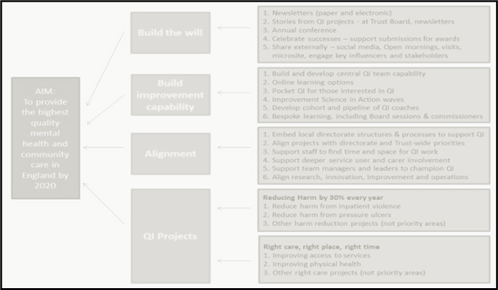
INSERT TITLE
INSERT PROJECT TEAM MEMBERS with institution
QI COACH or SPONSOR can also be included here if applicable
Add your logo here
Background
Results / Driver diagram
This contains your introduction/aims. You may edit the font, colours or the headings if you wish.
What was the outcomes ?
Change process?
Or results?
Or outcome from the reflections
Methods or Tests of Change
Discussion
Conclusion
How has this impacted your work individually and as a service?
Take home messages,
barriers to the project.
What have you learnt from this Project?
These are the ideas that your team tested and implemented.
What is your learning point from your piece of work or reflection?
References & Acknowledgments
References, appendix or acknowledgements

